Slide 1

Paediatric and Adolescent Gynaecology
Dr Cara Williams
Consultant Gynaecologist
Liverpool Women’s Hospital
Alder Hey Children’s Hospital

Slide 2
Looking Ahead. Embracing Innovation
Introduction
Common pre-pubertal problems
Adolescent menstrual dysfunction
Delayed puberty/Primary amenorrhoea
Congenital Gynaecological Anomalies – Complex Mullerian Duct Anomalies and Differences in Sex Development
Premature Ovarian Insufficiency
Turner Syndrome
Mayer Rokitansky Kuster Hauser Syndrome
Female Genital Cosmetic Surgery requests

Slide 3
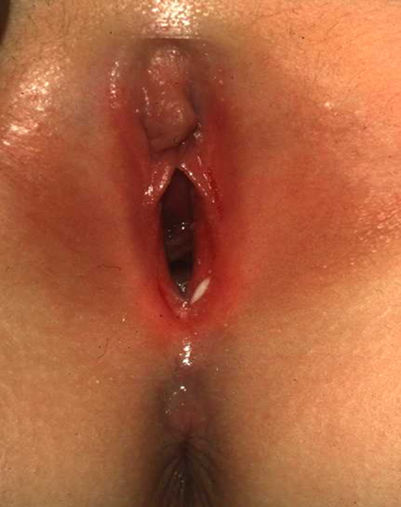
Looking Ahead. Embracing Innovation
Vulvovaginitis
Most common cause of symptoms before puberty
3-8 years (6 months up to puberty)
Symptoms:
-Discharge (green, yellow, foul smelling)
-Itching
-Pain
-Dysuria
Examination:
-Erythema around vulva and anus
-Excoriated
-Dry skin
-Discharge
-Associated labial adhesions

Slide 4
Looking Ahead. Embracing Innovation
Vulvovaginitis
Investigations:
Low Vaginal Swab
Up to 80% non-infectious/non-specific¹
Thrush unlikely as vaginal pH too alkaline
Mainly respiratory/enteric pathogens
  -Grp A Strep
  -Haem influenza
  -Staph aureus
  -Strep pneumonia
Chlamydia/Gonorrhoea/Trichomonas – indicate sexual abuse
Management
Hygiene (wiping front to back)
Emollients
Avoidance of soaps and perfumed products
Cotton underwear
Avoid constipation
No antifungal creams unless found on culture
Night time pain or itching could indicate threadworms – consider Mebendazole

Slide 5
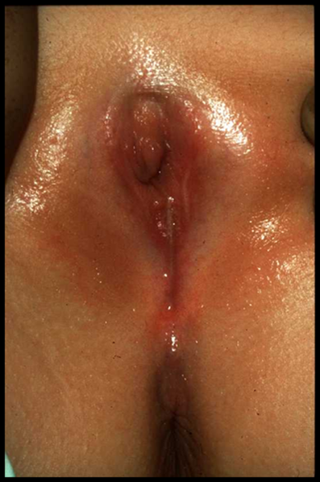
Looking Ahead. Embracing Innovation
Labial Adhesions
Majority asymptomatic
Many have associated vulvovaginitis
Post-void dribbling, UTI, vulval irritation
40% resolve without treatment within a couple of years²
Virtually all resolve with onset of puberty
Treatment:
-Reassurance
-Emollients
-Topical Oestrogen cream
- Pea-sized amount, twice daily, up to 6 weeks
- Breast budding/vaginal bleeding – resolve on stopping treatment
- Recurrence common
- Only if child symptomatic

Slide 6
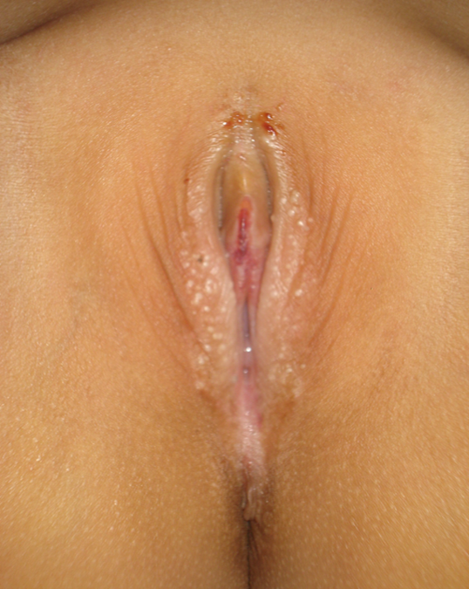
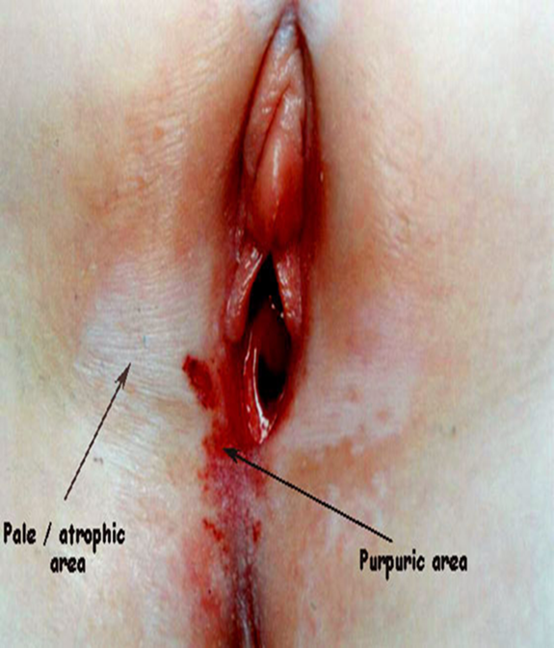
Looking Ahead. Embracing Innovation
Lichen Sclerosus
Symptoms:
Itching
Pain
Dysuria
Bleeding from erosions or fissures
Pain on defecation/constipation
Examination:
Hypopigmented
Figure of 8
Ecchymoses/purpura/fissures/erosions
Scarring/fusion/introital narrowing – less common
Can be confused with sexual abuse
Treatment:
Potent topical steroid (Clobetasol propionate)
Once a night 4 weeks, Alternate nights 4 weeks, Twice weekly 4 weeks
Emollients and soap substitutes
Recurrence common
Tacrolimus 0.1% – steroid sparing agent³
Most resolve at puberty but not all
Low malignancy risk

Slide 7
Looking Ahead. Embracing Innovation
Pre-pubertal vaginal bleeding
History
Duration
Trauma
Other signs of pubertal development
Foreign body insertion
Concerns regarding sexual abuse
Examination
Pubertal assessment – Tanner staging (A,B,P 1-5)
Genital exam:
  Trauma
  Vulvovaginitis
  Lichen Sclerosus
  Urethral prolapse
  Tumour
Investigations:
Hormone profile: LH/FSH/E2
USS
Hand and wrist XRay for Bone age
EUA – cystoscopy/vaginoscopy
Isolated premature menarche
Diagnosis of exclusion (after ruling out foreign body/trauma/precocious puberty/tumour)
Benign variant of normal
May recur but expect puberty to occur at the normal time

Slide 8

Looking Ahead. Embracing Innovation
Adolescent Menstrual Dysfunction
Severe menstrual dysfunction affects 25% teenage girls⁴
Affecting life activities
School absence
Improves with age
Irregular periods
Prolonged bleeding
Menorrhagia
Dysmenorrhoea
Mood disturbance

Slide 9
Looking Ahead. Embracing Innovation
Adolescent Menstrual Dysfunction
Relative immaturity of the hypothalamic-pituitary-ovarian axis
>50% cycles anovulatory in first 2 years
Cycle frequency <20 - >90 days
Anovulatory cycles often heavy and prolonged (several weeks)
Iron Deficiency Anaemia
Circulatory collapse
Anovulatory cycles pain-free
Heavy bleeding can be associated with pain
Regular ovulatory cycles –> increased circulating prostaglandins -> pain

Slide 10
Looking Ahead. Embracing Innovation
Adolescent Menstrual Dysfunction – Investigations
FBC and Ferritin
50% Iron deficiency
< half detected with FBC alone⁵
Coagulation screen
With von Willebrand’s screen
Symptoms suggestive of a bleeding disorder
Symptoms not responsive to hormone treatments
Hormone profile
Including androgens (Testosterone, Androstenedione, DHEAS)
Suspecting Polycystic Ovary Syndrome
Ultrasound
Transabdominal if virgo intacta
Ovarian morphology – only if >8 years since menarche (International Guideline on PCOS)⁶
Endometrial pathology - very rare
Pelvic pain/dysmenorrhea – to look for obstructed Mullerian duct anomaly or endometrioma

Slide 11
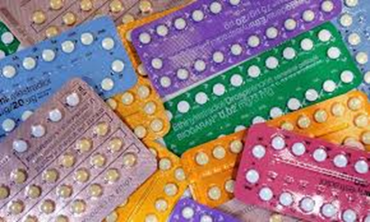
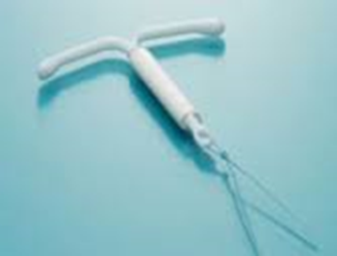
Looking Ahead. Embracing Innovation
Adolescent Menstrual Dysfunction – Management
What does the girl/parents want?
Reduce flow
Reduce pain
Reduce frequency
Make periods more manageable
Make periods more regular
Stop periods completely (girls with severe learning disability/complex needs)
Contraception
Lack of evidence for use in adolescents
Evidence extrapolated from adult data
Hormonal treatments
Safe
Can be used anytime after menarche

Slide 12
Looking Ahead. Embracing Innovation
Adolescent Menstrual Dysfunction – Treatment options
Non-hormonal
Tranexamic Acid 1g tds
Mefenamic Acid 500mg tds (may need reduced dose in younger patients)
Cyclical progestogens
Norethisterone 5mg BD/TDS - 21/28
Medroxyprogesterone Acetate 10mg BD/TDS - 21/28
No trials comparing NET/MPA
MPA lower thrombosis risk
Progestogen-only-contraceptive pill
Desogestrel 150mcg – double contraceptive dose
Amenorrhoea significantly higher with double dose (49% vs 18%, p=0.001)⁷
No significant increased risk of side effects (low mood, increased appetite, irregular bleeding)

Slide 13
Looking Ahead. Embracing Innovation
Adolescent Menstrual Dysfunction – Treatment options
Combined hormonal contraception
Very effective at reducing menstrual flow and pain
Anti-androgenic pill if PCOS/acne
Breakthrough bleeding - increase dose of E2
Tricycle or continuous with 4 day break
VTE – background risk 15-19 years 1.83/10,000
Very low baseline risk of breast cancer on adolescence
Levonorgestrel releasing intra-uterine system
Prevents endometrial proliferation
25% inhibits ovulation
Useful when other treatment methods ineffective or oestrogen contra-indicated
Irregular bleeding first 3-6 months
Adult data - 90% reduction in blood loss and 65% amenorrhoea at 12 months
Effective in adolescents with menorrhagia and dysmenorrhoea⁸
Can be used anytime after menarche
General Anaesthetic/sedation if virgo intacta

Slide 14
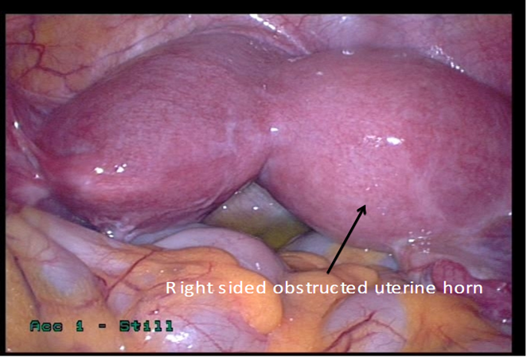
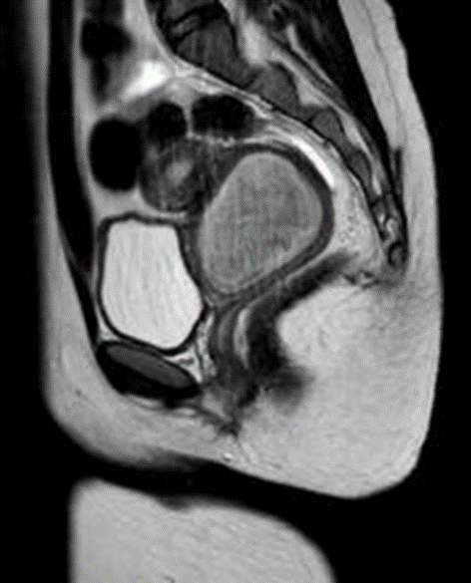
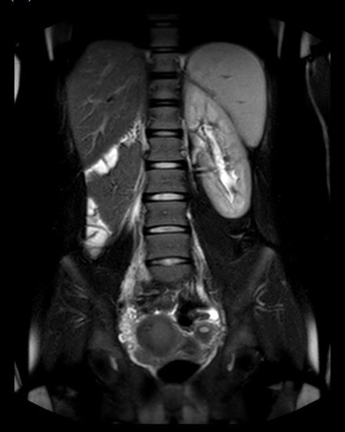
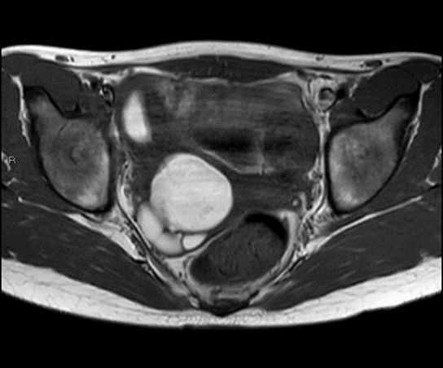
Looking Ahead. Embracing Innovation
Dysmenorrhoea
Endometriosis
>35% adolescents with chronic pelvic pain refractory to medical management found to have endometriosis at laparoscopy⁹
Medical treatments first line – COC/POP/Mirena/NET
Failed medical treatment – laparoscopy +/- resection of endometriosis
Obstructed Mullerian Duct Anomaly
Obstructed non-communicating uterine horn
  Laparoscopic resection of uterine horn
Obstructed hemi vagina with ipsilateral renal anomaly – OHVIRA syndrome
  Resection of vaginal septum

Slide 15
Looking Ahead. Embracing Innovation
Delayed puberty and Primary amenorrhoea
95% will achieve Breast Tanner stage B2 by 13yrs
95% will have Menarche by 14.5yrs¹⁰
Delayed puberty
Investigate at 13 years
Primary amenorrhoea with normal secondary sexual characteristics
Refer at 15 years OR
More than 2 years since start of breast development
Investigations:
Hormone profile (LH, FSH, E2, PRL, Androgens, TSH)
Pelvic USS
LHRH test
MRI pelvis (if unable to see uterus on ultrasound)
MRI pituitary
Karyotype

Slide 16
Looking Ahead. Embracing Innovation
Delayed puberty and Primary amenorrhoea - Causes
Delayed puberty
Constitutional delay
Hypogonadotrophic hypogonadism (50% Kallmanns, 50% idiopathic)
Premature Ovarian Insufficiency
Turner Syndrome
Differences of Sex Development (DSD)
Surgical hypogonadism
Primary amenorrhoea with normal secondary sexual characteristics
PCOS
Hypothalamic amenorrhoea (eating disorders, excessive exercise)
Mayer Rokitansky Kuster Hauser Syndrome (MRKH)
Premature Ovarian Insufficiency
Turner Syndrome
Differences of Sex Development (DSD)

Slide 17
Looking Ahead. Embracing Innovation
Congenital Gynaecological Anomalies – Differences of Sex Development
A group of conditions in which the development of chromosomal, gonadal or anatomical sex is atypical
Consensus statement 2006
46XX DSD
Congenital Adrenal Hyperplasia
Ovotesticular DSD
Gonadal Dysgenesis
MRKH, Cloacal extrophy
46XY DSD
Abnormal gonadal development eg pure/partial gonadal dysgenesis
Defect in androgen biosynthesis eg 5α reductase deficiency, 17β hydroxysteroid dehydrogenase deficiency
Defect in androgen action eg Complete/Partial Androgen Insensitivity Syndrome
Congenital anomalies of genitalia eg cloacal extrophy
Chromosomal DSD
Turner Syndrome and variant (45X0)
Klinefelters (47XXY)
Mixed gonadal dysgenesis (45X/46XY)
Ovotesticular DSD (46XX/46XY)

Slide 18
Looking Ahead. Embracing Innovation
Congenital Gynaecological Anomalies – Mullerian Duct Anomalies
Transverse vaginal septum
Vaginal/cervical/uterine agenesis
Vaginal septum
Obstructed hemi vagina
Obstructed non-communicating uterine horn
ACUM – Accessory Cavitated Uterine Mass
Multi-disciplinary Team
All congenital gynaecological anomalies should be managed by a multi-disciplinary team in a specialist tertiary centre
Endocrinology
Urology/Surgery
Psychology
Gynaecology
Genetics
Radiology
Specialist Nurse

Slide 19

Looking Ahead. Embracing Innovation
Premature Ovarian Insufficiency
<40yrs 1:100
<30yrs 1:1000
<20yrs 1:10,000
Diagnosis:
2 x FSH>25 more than 4 weeks apart¹¹
Investigations:
Karyotype
Fragile X
Autoantibodies (adrenal and thyroid)
Vit D/Ca
BMD (every 3-5 years)
Management:
HRT until at least 50yrs
Cyclical or continuous combined
High dose 2-4mg/100mcg Estradiol
COCP – continuous high dose pill (poor evidence relating to bone health)
Contraception – spontaneous pregnancy can occur although rare (<5%)
Vitamin D/Calcium
Egg donation IVF/Adoption
www.daisynetwork.org.uk

Slide 20
Looking Ahead. Embracing Innovation
Turner Syndrome
25-50/100,000 females
Phenotypic female with a karyotype containing one X Chromosome and complete or partial absence of the second X Chromosome in association with one or more clinical manifestations
(Excluding: deletion distal to Xq24 or women over 50 with 5% 45X mosaicism)
Multisystem involvement
Short stature
Delayed puberty
Infertility
Bicuspid aortic valve
Coarctation of the aorta
Aortic dilatation/aneurysm
Aortic stenosis
Ischaemic heart disease, Hypertension, Stroke
SN Hearing loss
Lymphoedema
Hypothyroidism
Diabetes
Dyslipidaemia
Deranged liver function
IBD
Coeliac disease
Renal anomalies (horseshoe kidney, renal agenesis)
Osteopaenia/osteoporosis
Cognitive and psychosocial problems

Slide 21
Looking Ahead. Embracing Innovation
Turner Syndrome – Management
Growth and Puberty
Growth Hormone +/- Oxandralone (until growth velocity slows)
Spontaneous puberty possible in TS mosaic
Regular menstrual cycles – 6%
Induction of puberty aged 11-12 years
Transdermal Estradiol patches in incremental doses over 2-3 years
Progestogen added when breakthrough bleeding starts
Combined HRT until 50 years
BMD every 3-5 years
Cardiovascular Health
Echocardiogram
MR aortagram
Frequency of imaging guided by Cardiologist with special interest in aortopathies
Low threshold for antihypertensives
Psychological support
High levels of shyness and social anxiety
Reduced self-esteem
Increased risk of social isolation, and obsessive behaviour
10% intellectual disability
50-75% dyscalculia

Slide 22
Looking Ahead. Embracing Innovation
Turner Syndrome – Management
Fertility
Spontaneous pregnancy 4.8-7.6%
Miscarriage after spontaneous pregnancy 30.8-45.1%¹² (general population 20%)
Infertility one of the greatest issues affecting QoL
Fertility preservation for those with persistent ovarian function
Oocyte cryopreservation following controlled ovarian hyperstimulation (>12 years)
Pregnancy through ovum donation IVF
Surrogacy and adoption
Pregnancy
Increased risk of hypertension, pre-eclampsia, diabetes and Caesarean section
Normal cardiac screening prior to pregnancy does not preclude possibility of aortic dissection/rupture
Pre-pregnancy counselling for ALL women with TS
MRA within 2 years of pregnancy
Strict BP control (135/85mmHg)
Careful monitoring of renal function
Consider LDA from 12 weeks until delivery to reduce risk of PET
ASI <2cm/m2 – vaginal delivery
ASI >2cm/m2 – epidural analgesia and expedited vaginal delivery or CS¹³

Slide 23
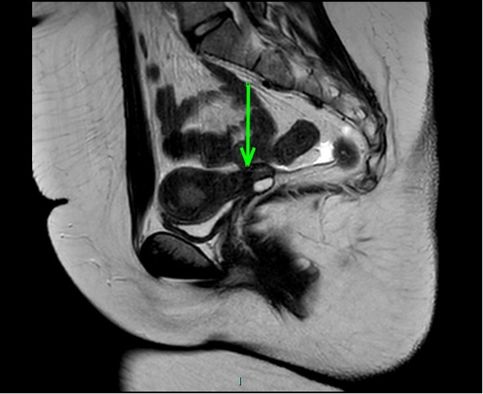
Looking Ahead. Embracing Innovation
Mayer Rokitansky Kuster Hauser Syndrome (MRKH)
Failure of fusion of Müllerian ducts resulting in hypoplasia of uterus and vagina
1:4500
Ovarian function normal - ectopic
Primary amenorrhoea with normal secondary sexual characteristics
MRI - 90% will have rudimentary uterine buds but these are usually small and undifferentiated ¹⁴
  Functional endometrium resulting in pain - laparoscopic resection.
Management
Creation of a functional vagina
  Vaginal dilation
  85% success
  Dedicated support
  Unsuccessful dilation – laparoscopic Vecchietti
    Traction vaginoplasty
PSYCHOLOGICAL SUPPORT
Fertility
  Surrogacy
  Adoption
  Uterine transplant

Slide 24



Looking Ahead. Embracing Innovation
Requests for Female Cosmetic Genital Surgery
Common problem in adolescent gynaecology
No scientific evidence to support the practice of labiaplasty
No medical requirements
British Society of Paediatric and Adolescent Gynaecology (BritSPAG) and RCOG Position Statement 2013:
‘Labiaplasty should not be performed on girls under the age of 18’
Management
Education about normal genital development and anatomy
Ease discomfort
  Stop shaving
  Avoid soaps and perfumed products
  Emollient soap substitute
  Emollient moisturiser
Support
  Reassurance
  Parental support
  Psychology

Slide 25
Looking Ahead. Embracing Innovation
References
1. Jaquiery A, Stylianopoulos A, Hogg G, Grover S. Vulvovaginitis: clinical features, aetiology, and microbiology of the genital tract. Archives of Disease in Childhood 1999;81:64-67.
2. Norris J et al. Spontaneous resolution of labial adhesions in pre-pubertal girls. J Paediatr Child Health 2018 Jul;54(7):748-753.
3. Anderson K et al. A retrospective analysis of pediatric patients with lichen sclerosus treated with a standard protocol of class I topical corticosteroid and topical calcineurin inhibitor. J Dermatolog Treat 2016;27(1):64-6.
4. Parker MA, Sneddon AE, Arbon P. The menstrual disorder of teenagers (MDOT) study: determining typical menstrual patterns and menstrual disturbance in a large population-based study of Australian teenagers. BJOG 2010 Jan;117(2):185-92.
5. Johnson S, Lang A, Sturm M, O'Brien SH. Iron Deficiency without Anemia: A Common Yet Under-Recognized Diagnosis in Young Women with Heavy Menstrual Bleeding. J Pediatr Adolesc Gynecol. 2016 Dec;29(6):628-631.
6. International evidence based guideline for the assessment and management of polycystic ovary syndrome. Copyright Monash University, Melbourne Australia 2018.
7. Burton R, Williams C. Double-Dose Desogestrel: Is it Effective in Adolescent Menstrual Dysfunction? J Pediatr Adolesc Gynecol 2021 Oct;34(5):662-665.
8. Adeyemi-Fowode OA, Santos XM, Dietrich JE, Srivaths L. Levonorgestrel-Releasing Intrauterine Device Use in Female Adolescents with Heavy Menstrual Bleeding and Bleeding Disorders: Single Institution Review. J Pediatr Adolesc Gynecol. 2017 Aug;30(4):479-483.
9. Stavroulis AI, Saridogan E, Creighton SM, Cutner AS. Laparoscopic treatment of endometriosis in teenagers. Eur J Obstet Gynecol Reprod Biol. 2006 Apr 1;125(2):248-50.
10. Royal College of Obstetricians and Gynaecologists. Sex Steroid Treatment for Pubertal Induction and Replacement in the Adolescent Girl. Scientific Impact Paper No.40 June 2013.
11. The ESHRE Guideline Group on POI, Webber L et al. ESHRE Guideline: management of women with premature ovarian insufficiency. Human Reproduction 2016;31(5): 926-937.
12. Gravholt CH, Andersen NH, Conway GS, Dekkers OM, Geffner ME, Klein KO, Lin AE, Mauras N, Quigley CA, Rubin K, Sandberg DE, Sas TCJ, Silberbach M, Söderström-Anttila V, Stochholm K, van Alfen-van derVelden JA, Woelfle J, Backeljauw PF; International Turner Syndrome Consensus Group. Clinical practice guidelines for the care of girls and women with Turner syndrome: proceedings from the 2016 Cincinnati International Turner Syndrome Meeting. Eur J Endocrinol. 2017 Sep;177(3):G1-G70
13. Silberbach M, Roos-Hesselink JW, Andersen NH, Braverman AC, Brown N, Collins RT, De Backer J, Eagle KA, Hiratzka LF, Johnson WH Jr, Kadian-Dodov D, Lopez L, Mortensen KH, Prakash SK, Ratchford EV, Saidi A, van Hagen I, Young LT; American Heart Association Council on Cardiovascular Disease in the Young; Council on Genomic and Precision Medicine; and Council on Peripheral Vascular Disease. Cardiovascular Health in Turner Syndrome: A Scientific Statement From the American Heart Association. Circ Genom Precis Med. 2018 Oct;11(10):e000048
14. Hall-Craggs MA, Williams CE, Pattison SH, Kirkham AP, Creighton SM. Mayer-Rokitansky-Kuster-Hauser syndrome: diagnosis with MR imaging. Radiology. 2013 Dec;269(3):787-92

Slide 26

Looking Ahead. Embracing Innovation
Thank you!

